Slide 1

Autonomous Target Acquisition
(group-6)
Arun Sai S (08005053) TL
Pranav P (08005054)
Nikhil Simha R (08005058)
Swaroop Vajrapu (08005055)

Slide 2
Problem Statement
Detect a possible aerial target in the vicinity (up to 4 ft) in all directions.
Once detected, center the on board laser on the target and beep.
The bot after shooting at the target takes an image of the shot as proof of the shot.

Slide 3
Requirements
Detection: Any blue target of more than 30 sq. cm. in area within a distance of 5 ft must be detected.
Centering: Laser is shot when the below condition is satisfied:
The center of bounding box of the target, as defined by MATLAB must be within a distance of l/18 from the center of the image frame lengthwise and breadth wise.

Slide 4
Work Division
Arun Sai, Pranav Paruchuri --- coding, design
Nikhil Simha, Swaroop Vajrapu --- hardware, testing
Dates of Completion:-
Completion of hardware --- 4/04/11
Completion of software --- 6/04/11
Completion of testing --- 7/04/11
Completion of camera tracking --- 1/04/11

Slide 5
Project Plan
Implement Serial Communication || Prepare Servo Assembly
Test Serial Communication against Servo assembly.
Implement Image Processing Logic || Mount camera
Test centering (Note: no laser yet)
Mount Laser || Change serial communication code to support Laser.
Final Testing (includes laser calibration)

Slide 6
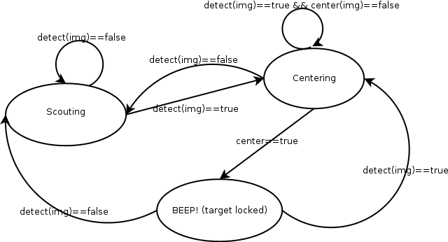
FSM

Slide 7
FSM Description
detect(img): returns true if a contiguous blue object cover of greater than 3000 pixels
center(img): returns true if the center of bounding box of blue object is at most l/18 distant according to both the axes where l is the length of that axis.
Scouting: corresponds to movement of camera in a zig-zag path on a (imaginary) cylindrical surface whose axis is vertical passing through center of the box
Centering: Move camera ((left or right) && (up or down)) corresponding to the location of object center in the current frame in steps of 5 degrees.

Slide 8
Innovation & Challenges
Model design supports an uncontrolled environment, i.e. a background color need not be specified or external visual noise is filtered out.
Laser Design initially proved to be difficult as the servo ports provided 5 V but the laser required 3 V. But we later found out that 5 V lasers are easily available.
One of the servo motors malfunctioned, hence we had to trade precision by using the DC motors of the bot instead to do the job.
Laser calibration proved to be a difficult task as movement of camera disturbed the calibration.

Slide 9
Tasks Completed
Scouting the arena for a target.
  Finding an efficient scouting algorithm.
  Since the servo motor in horizontal plane is not working the efficient algorithm is that it scans the vertical plane then after it scans it totally it then turns a small angle and does it again.
Identification of the target.
  The image is first run through a Wiener filter and then the holes in the object are filled and largest object is identified and when it surpasses a minimum size it is recognized as the target.

Slide 10
Tasks Completed
Centering the camera:
The camera is centered on the center of the object by sending the signals appropriate based on the nine block logic.
Firing the laser:
The firing of the laser is accomplished by rigging the laser to servo motor 3 and activated when needed to fired.

Slide 11
Test Cases
Phase 1:
Serial Communications tested.
Phase 2:
Matlab module to center image is tested independently(with just a camera).
Phase 3:
Integration of both.
Phase 4:
Laser centering and calibration tested and ready to go!

Slide 12
Performance Metrics
Standardized in Parallel with testing.
Phase 1 & 2 : precision & response of servo motor + DC motor assembly is limited. Centering in range of l/18 of frame size.
Phase 3 & 4:
Laser calibrated to shoot close to center with a 3 cm error (tangential plane).
Performance:
The performance as measured under laboratory conditions is that the bot hit 2/3rd of times.While it misses in 15th of the times by less than 2 inches.

Slide 13
Delays in the project
There is a delay of 50ms in the case of the movement of servo motors by 10 degrees and a delay of 50 ms in the left movement of the bot.
The communication delay is negligible since the communication is through serial cable instead of zigbee.

Slide 14
Re-Usability Features
The servo+serial communication module is generic in the sense that it can be used to provide two degree control over any servo assembly with built-in functions.
The matlab code detects any object that can be specified as 'x' number of contiguous pixels of a particular color and removes external noise.
The code is modular. The scouting and centering modules are independent.
The signals to the bot from matlab are hardware independent i.e. standard serial port communication characters.
If we change the hardware in the firebird we just need to change the code in the bot not pc.
The code is well commented.
The code is documented using the doxygen.

Slide 15
Future Enhancements
With another working servo motor precision to shoot a moving target can be acheived.
With two mounted cameras and lasers each having their own servo assembly the range can be greatly increased due to distance information. And also calibration disturbance due to cam movement will be absent.
Can be extended with a UI to show a lock on target like in airplanes and also to choose among targets (This requires complex image processing).

Slide 16
Future Enhancements
A mechanical gun can be mounted in the place of the laser gun and the object centered around the laser of gun instead of center of the camera.

